Slide 1
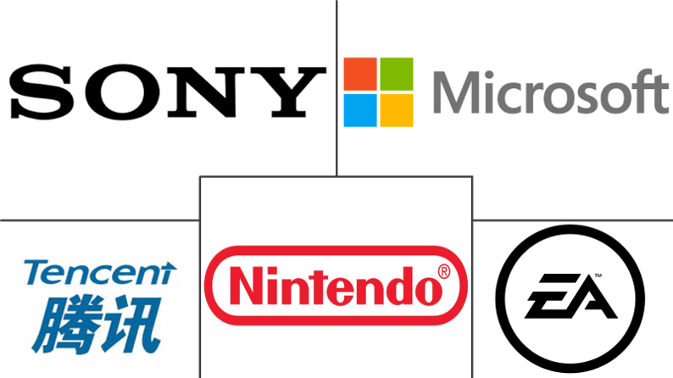

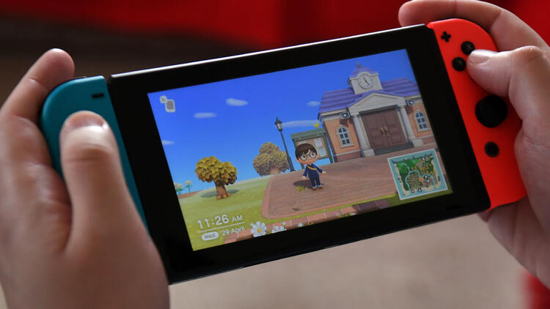
Games and game Development

Slide 2
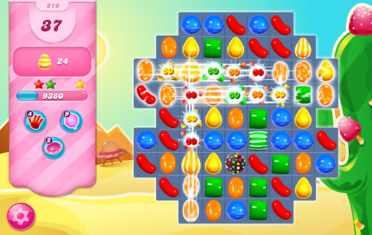
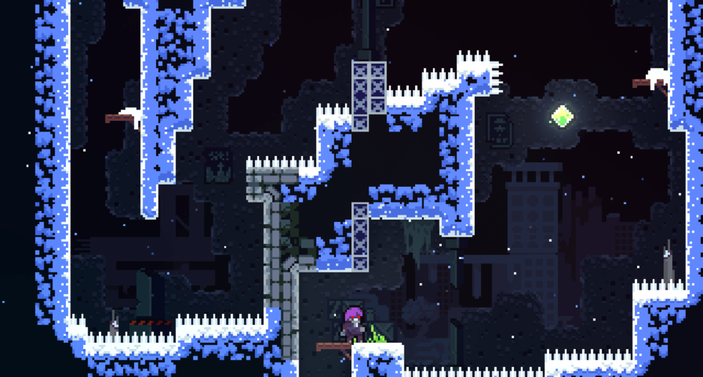
Game Development
What is game development?
Game Development is the art of creating games and describes the design, development and release of a game.
Game Development can be undertaken by a large Game Development Studio or by a single individual
A game developer could be a programmer, a sound designer, an artist, a designer or many other roles available in the industry

Slide 3


You Can Become A Game Developer
The game developers who does not have a financial stability in a company.
You can become an indie game developer thanks to the Internet.

Slide 4
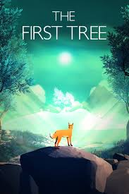
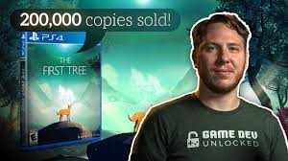
One Of My Favourite Indie Developer David Wehle
With this game he earned more than 150 thousand dollars(just in 1 year) in revenue and he spent around 10.000 dollars to made it. He said that it took about 1.000 hours to made it. After that game he became a full time indie developer. The game is made by Unity Engine which we will be talking abaut in a minute.
Notes:
https://www.youtube.com/watch?v=BEXIGytnOio

Slide 5


Game Engines
Game engine is something that combines what you code and design. They are free to use now but back than they were really really expensive for example 500.000 euros which was impossible to buy.

Slide 6
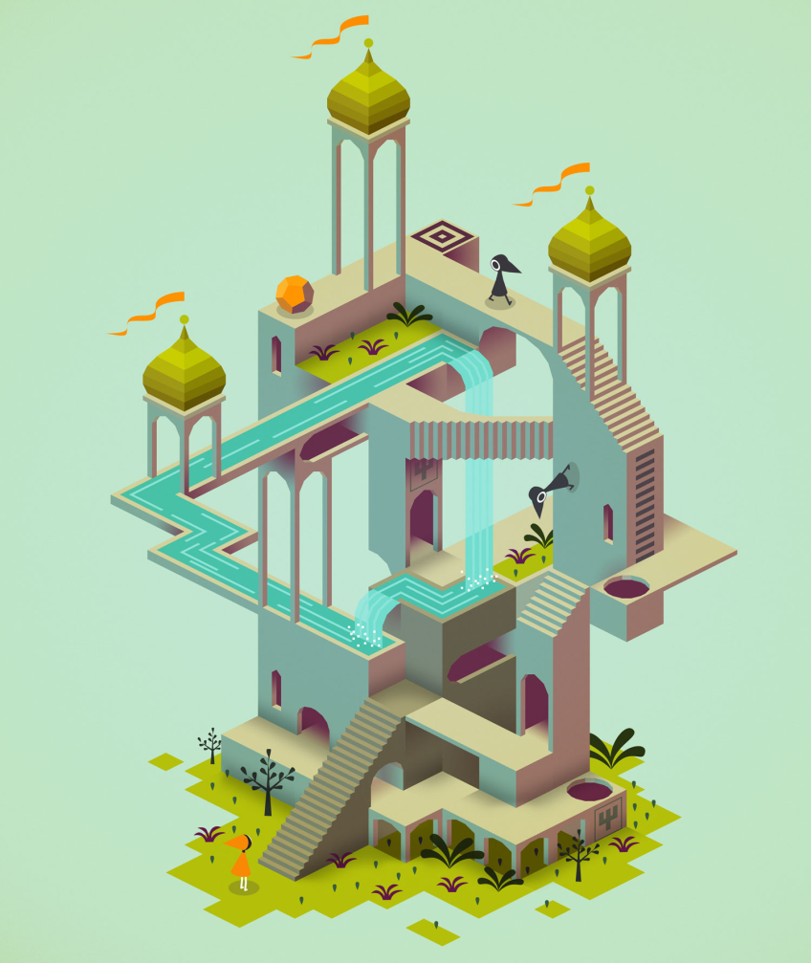
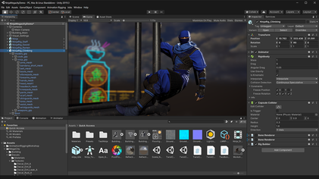
Popular Games Made With Unity
Notes:
https://www.youtube.com/watch?v=AUEyug7u-M4

Slide 7
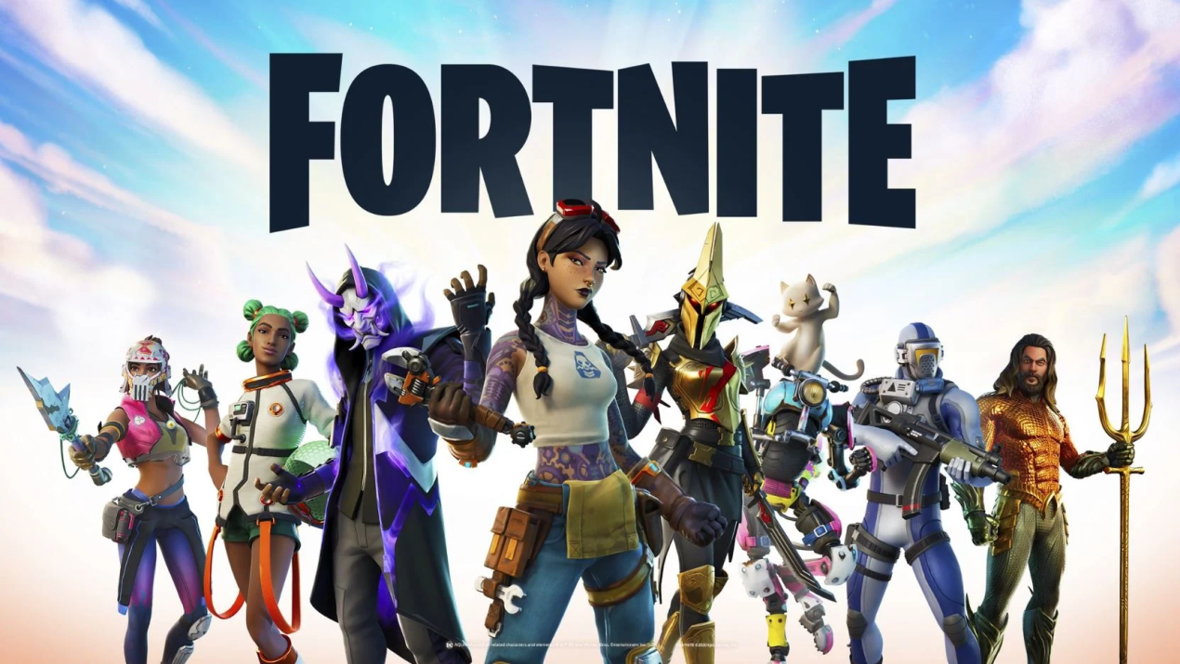

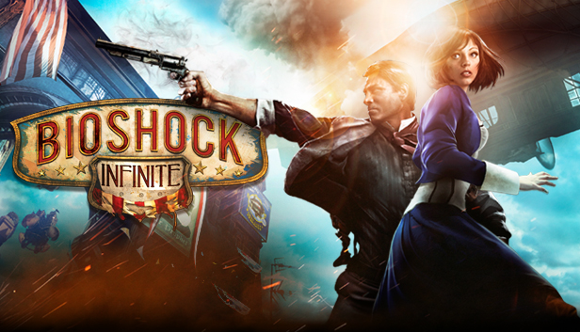
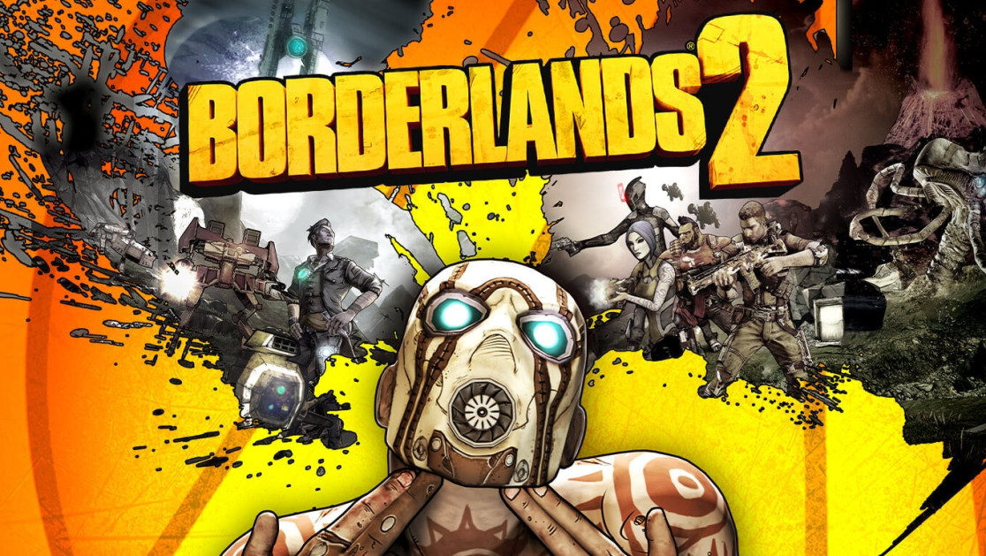
Popular Games Made By Unreal Engine
Notes:
https://youtu.be/lrPc2L0rfN4?t=57

Slide 8
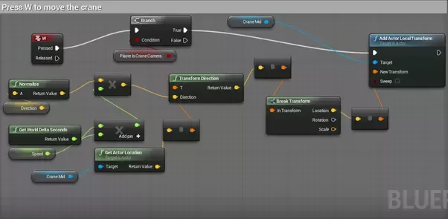
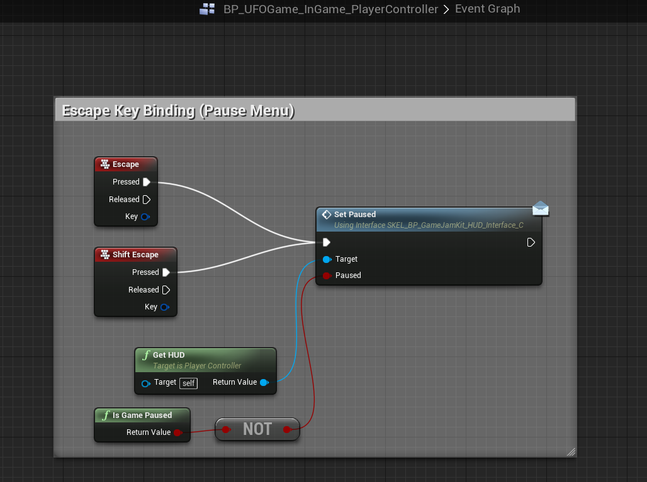
Unreal Engine
You can make a game without coding in unreal engine but of course you need to know the basics to understand what you are doing.

Slide 9

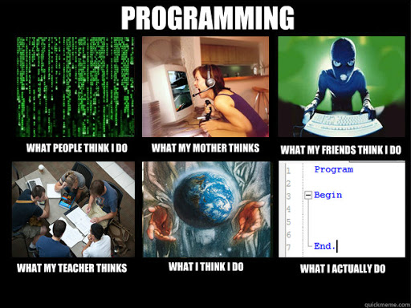
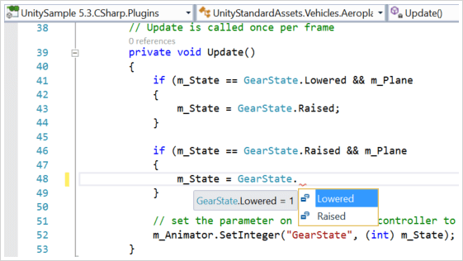
Coding

Slide 10
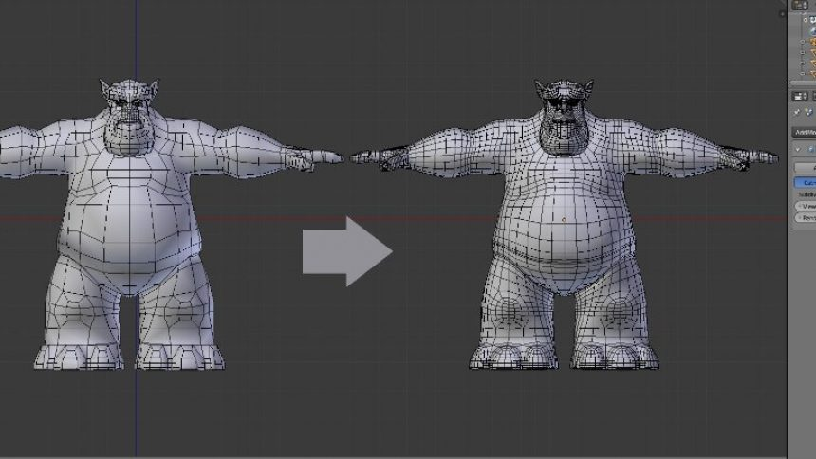
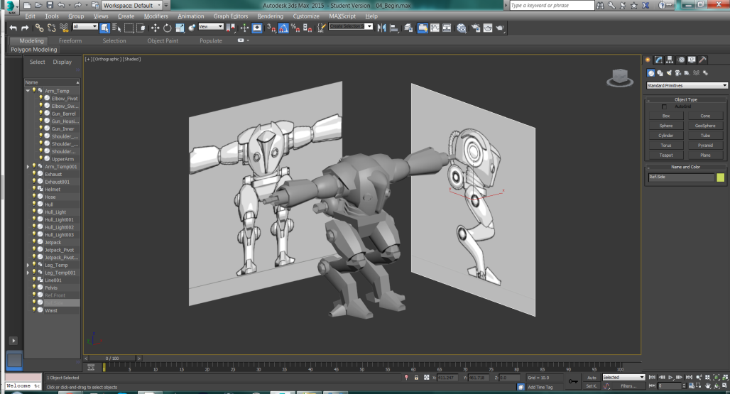
3D Art
A 3D Digital Game Artist uses their creativity, technology, and geometry skills to create fascinating animated experiences in a video game.
The 3D Digital Game Artist draws, models, and animates in different styles depending on the type of game, and is responsible for every aspect, from taking a designer’s brief to using creative, technical, and specialist skills to deliver a marketable game.
The artist needs a full understanding of concepts, art skills and animation as well as the ability to create and animate game characters.

Slide 11

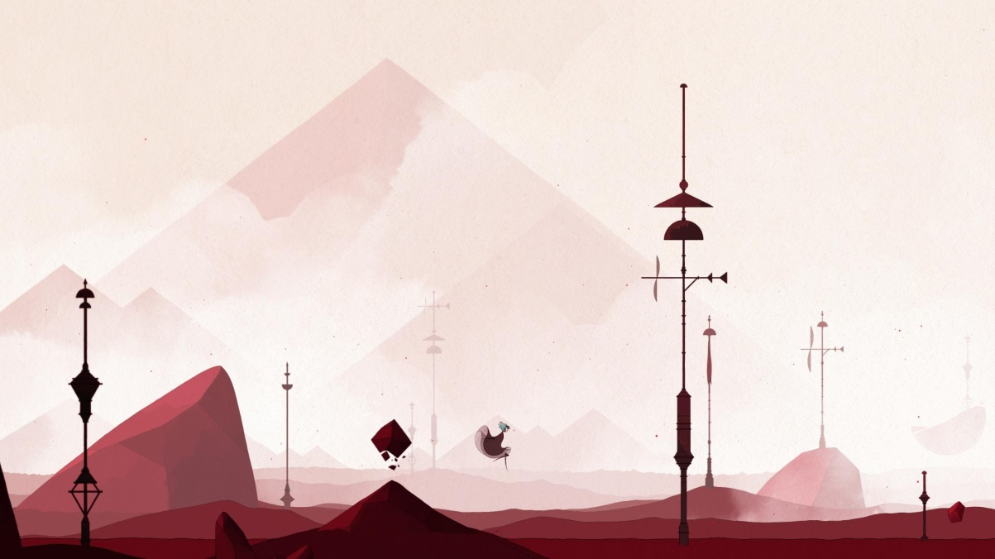
Artists
Effects Artists
Concept Artists
2D/Texture Artists
Environment Artists
3D Modellers
Sound Designer
Real artist
Normal Designer
Level Designer

Slide 12


Game Publishing
You can publish your game on Steam or Epic Games Store. Steam takes 30 percent of your total revenue and Epic Games take around 12 percent. I know that Steam looks like a scam but it is not because Steam has much more players than Epic Store and that means that a possibility of earning more by attracting much more people.

Slide 13

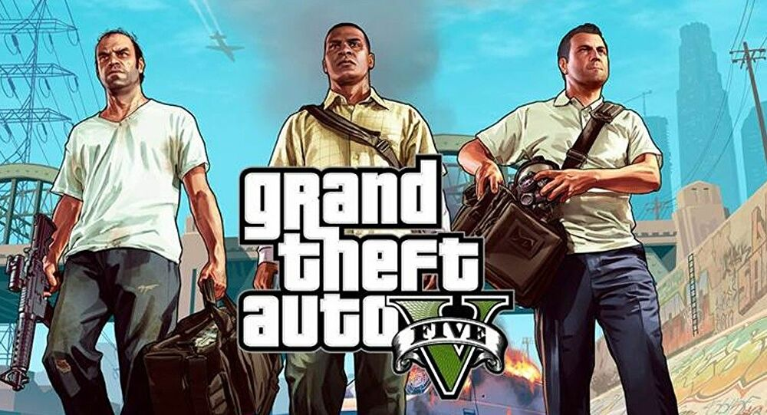
My Thoughts On Games
I think game industry will take over films in the future. Lets check the values of games and films. Gta 5 cost in between 137-265 million dollars and Avengers Endgame cost 356 million dollars. Lets check the revenue of those .Gta 5 made more than six billion dollars and continues to earn now by keeping the game up to date and avengers endgame made 2.8 billion dollars.

Slide 14

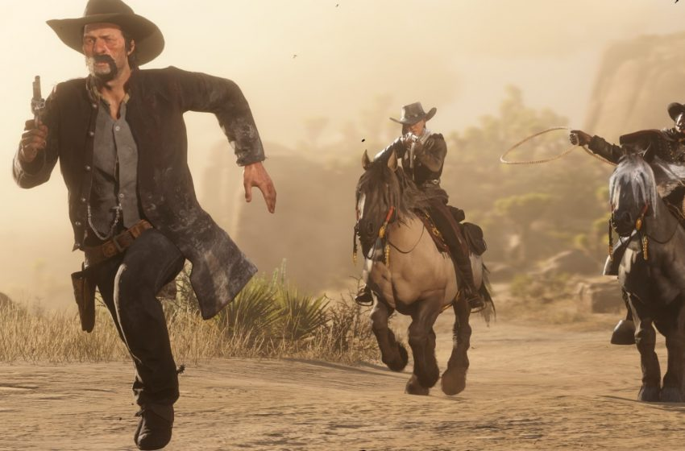
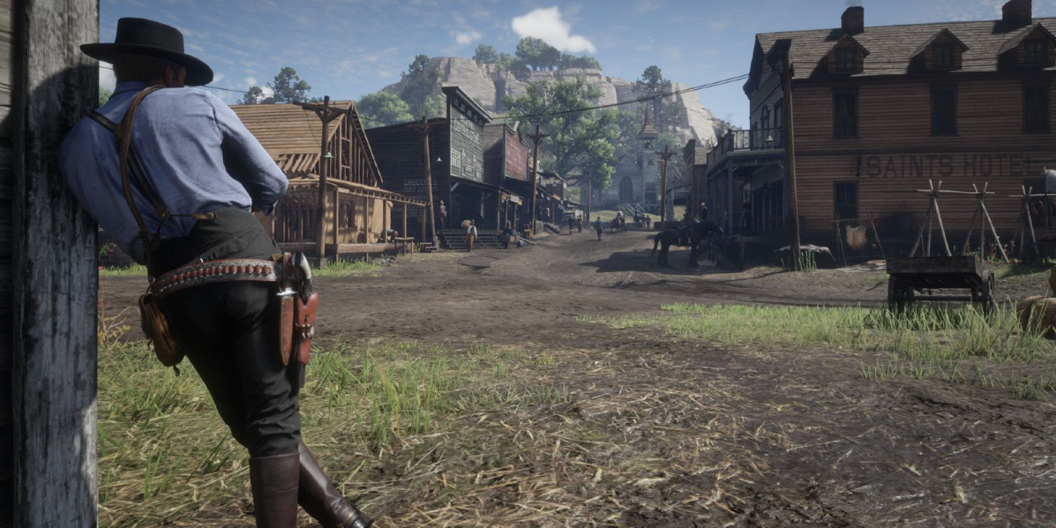
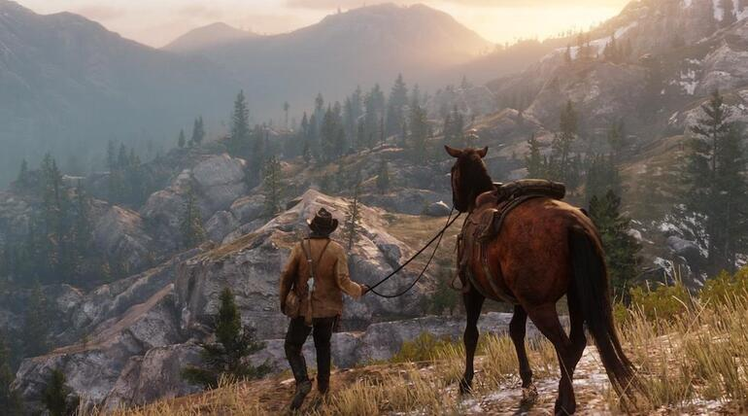
Some Of My Favourite Games
Notes:
https://www.youtube.com/watch?v=eaW0tYpxyp0

Slide 15
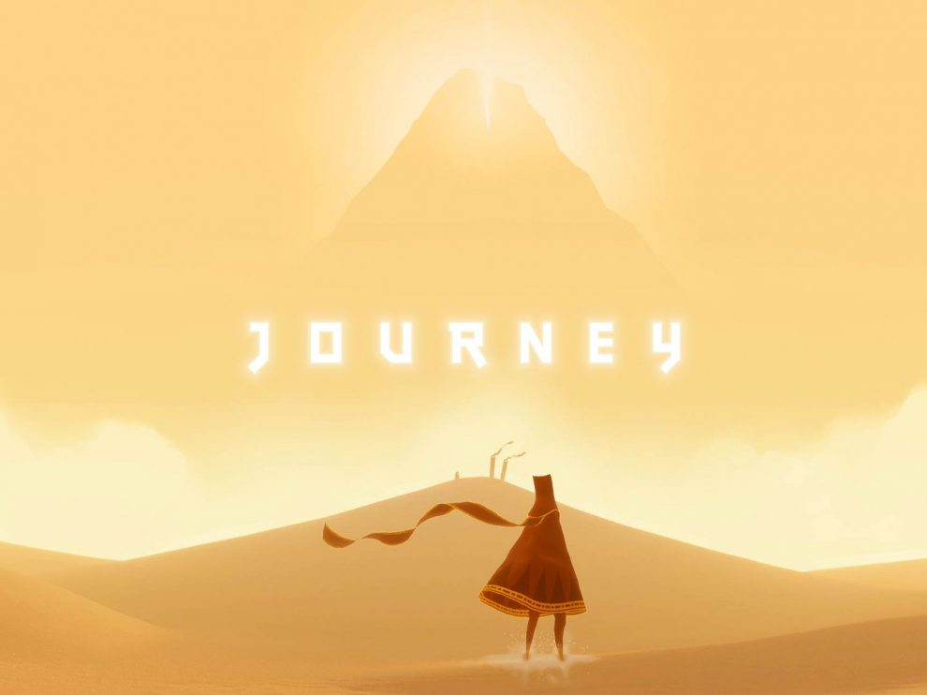
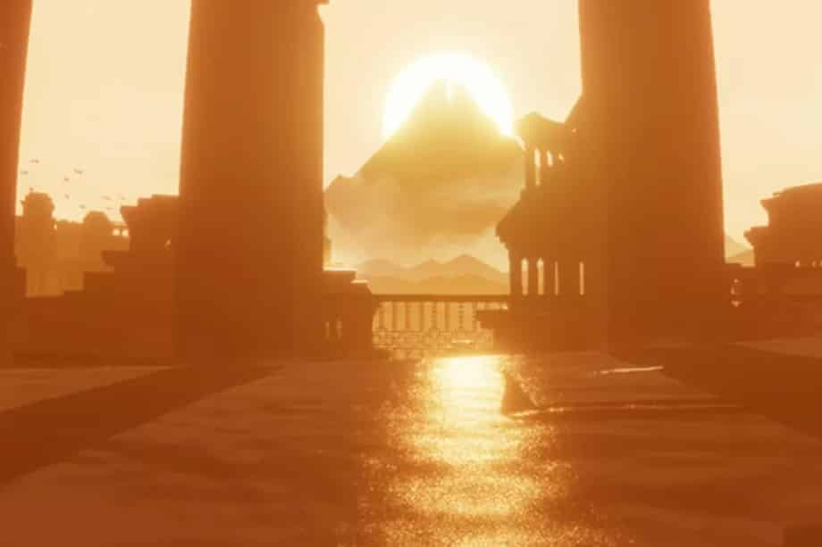
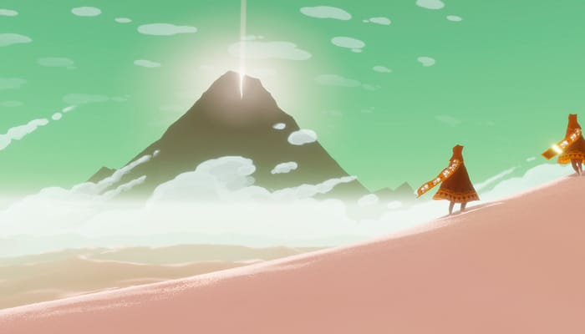
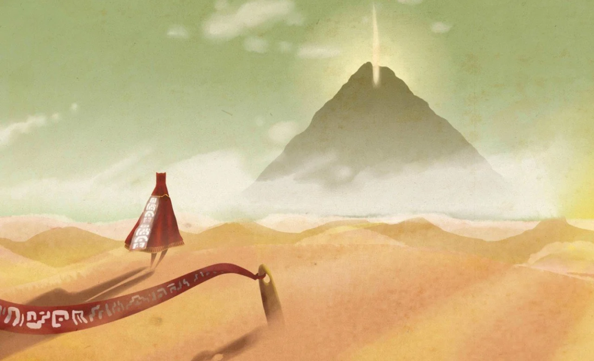
Some Of My Favourite Games
Notes:
https://www.youtube.com/watch?v=mU3nNT4rcFg

Slide 16

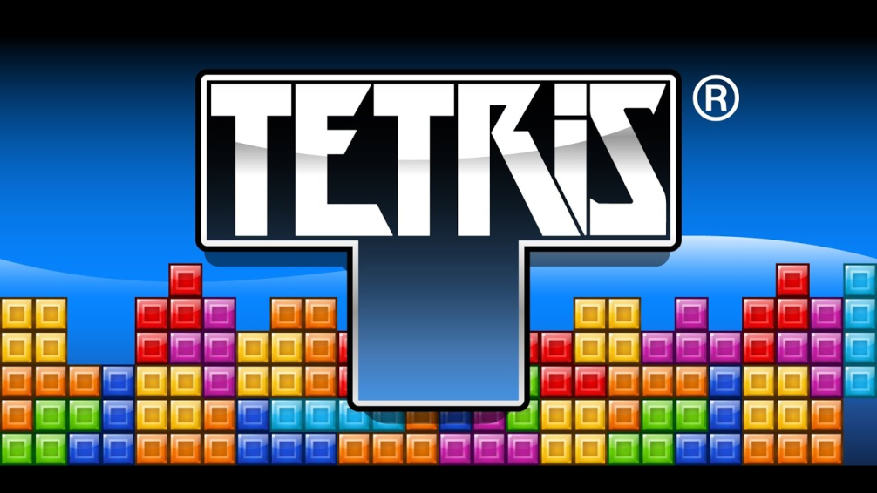
Thanks For Watching

Slide 17
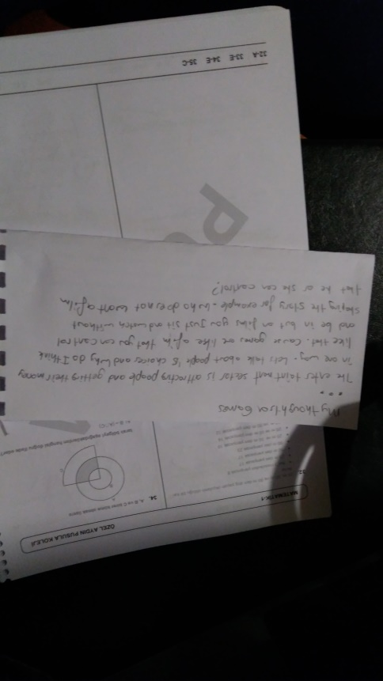

Slide 18
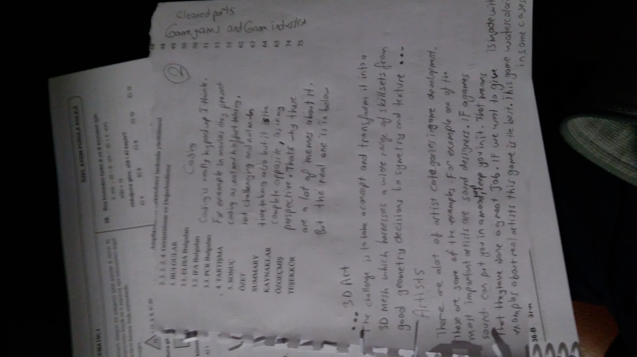

Slide 19
